Slide 1
How to Win Fast Money Using a Terrible NBA Betting Model
Isaac Chung and Brian Cha

Slide 2

Palate Cleanser:
Bird on Capybara

Slide 3

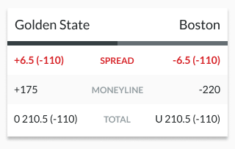
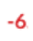
Our Vision
Isaac: NBA Fan
Brian: Friend makes bets on his own betting model
Goal: Create an accurate NBA betting model to help users make the most out of their $$$
Hypothetical Game:
Golden State: 97 points / Boston: 100 points
THE SPREAD →
Notes:
Spread: How much the team is expected to win by
Positive Numbers: represents the underdog, and you can win your money back or even a little more if the team wins or loses by less than the positive value (int). Of course if the underdog wins, you win a lot more.
Negative Numbers: represents the favored team. The favored team must win by more than the negative value (int) in order to win the money back (win by at least 7 pts)
Moneyline: how much money you will make or lose depending on the team you bet on (if the underdog wins, you will receive a lot more money than the favored team)

Slide 4




Starting Points
NBA_API
basketball-reference.com
Treasure trove of basketball data
Actually manageable!
Numpy/Pandas
Manipulate CSV data
Matplotlib
Visualize findings

Slide 5
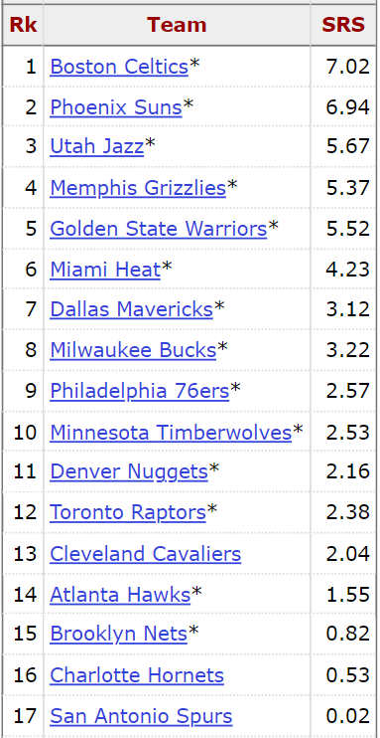
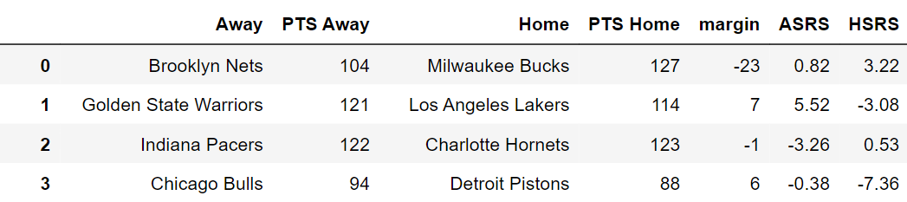
Progress… Start it Simple!
Important Variables:
Simple Rating System (SRS): average point differential
Higher → Better
Home/Away
“Home Court Advantage”
Tracking Every Game
Tracked all 1230 Games for the 2021-22 Season

Slide 6
Progress… Continued
Calculating the Margins
Margin = Away Team Points — Home Team Points
Negative → Away Team Lost
Positive → Away Team Won
Calculating ASRS and HSRS
ASRS = SRS value for Away Team
HSRS = SRS value for Home Team

Slide 7
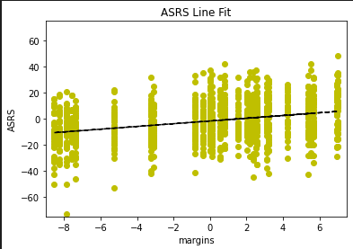
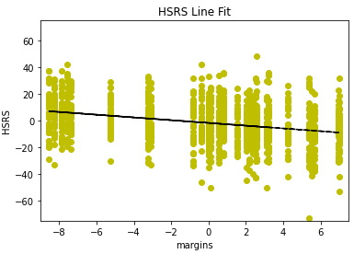
Progress… Continued
Relationship between Margin and HSRS/ASRS
Trendlines → Plot using matplotlib!
Top: Margin vs ASRS. Bottom: Margin vs HSRS
y-intercept → home field advantage!
Slope of ASRS and HSRS → Weights!
y = 1.04x - 1.72
y = -1.02x - 1.72

Slide 8
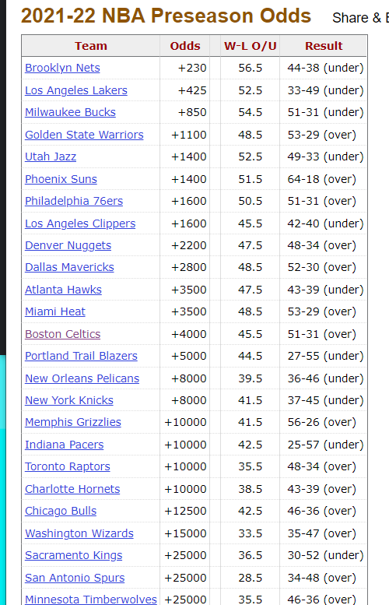
Progress… Continued
Predicted Margin of Matchup = Y-intercept (ASRS) + (ASRS Slope * ASRS) + (HSRS Slope * HSRS)
Betting Odds: Moneyline to Spread Converter (online resource)
PMM + Betting Odds:
Bet on Away Team! (++, -+)
Bet on Home Team! (--, +-)
Notes:
Negative pmm = away team is not favored by model; positive pmm = away team is favored by model

Slide 9
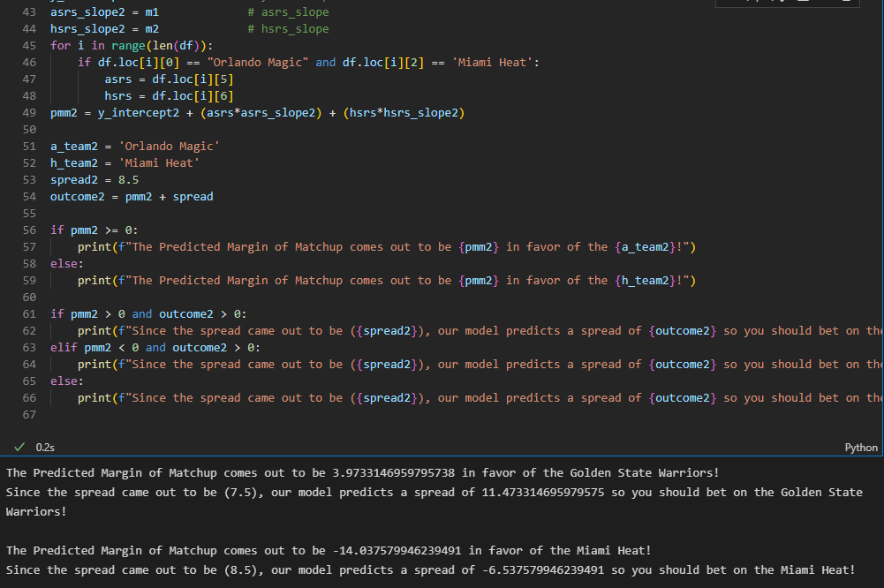
Examples
GSW/ORL: -350/+360 odds
LAC/MIA: +270/-500 odds
Spread = +7.5/+8.5
Predicted Margin of Matchup = +3.97/-14.04
Model Predicts: +11.47/-6.54

Slide 10
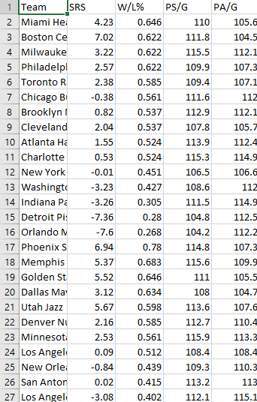
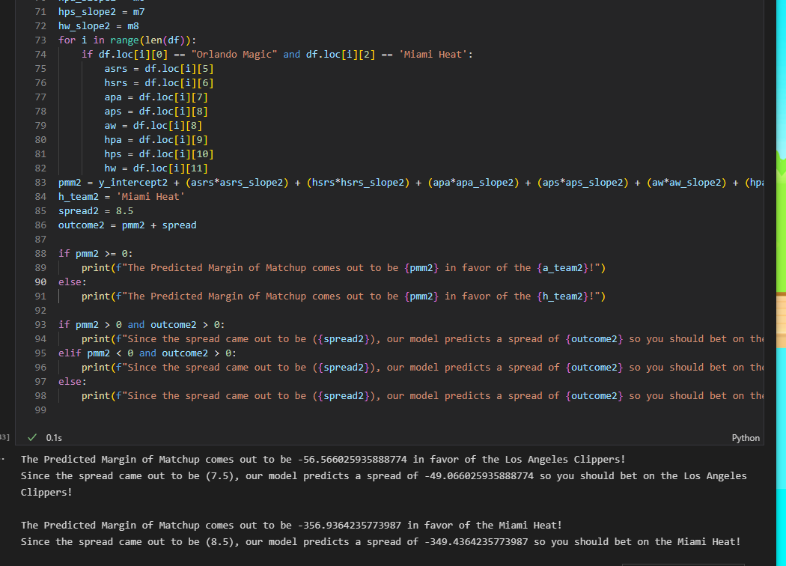
Examples 2
3 More Stats: W/L%, PS/G, PA/G
Relationship between Margin and SRS, W/L%, PS/G, PA/G
Predicted Margin of Matchup = -56.57/-356.94
Model Predicts: -49.07/-349.44

Slide 11
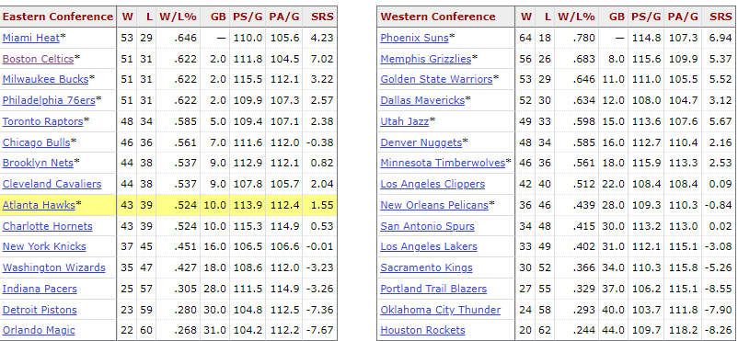
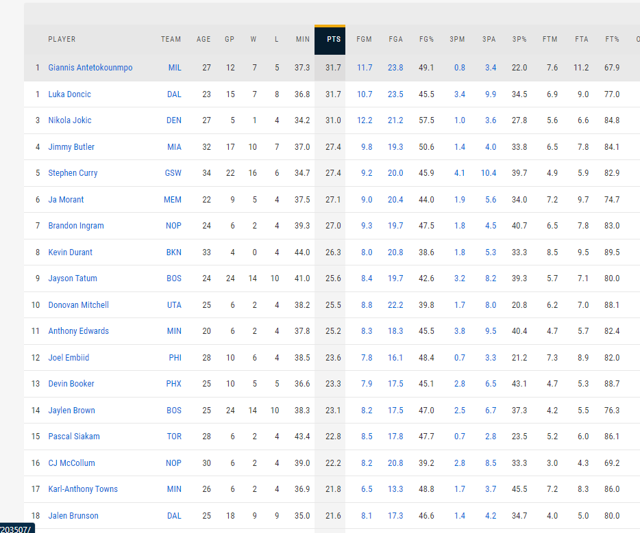
What’s Next?
Use previous season data
Utilize multiple statistics instead of solely SRS (or choosing some over others)
Hope: Betting Model can be used in different sports/occasions
Hope: Use player statistics too!
Example: Player efficiency rating
Reflection: Don’t use NBA_API
Notes:
As shown, there is a plethora of different player statistics and to account for them all is virtually impossible within our given time frame. There are 5 pages full of player stats for each player, and of course, there are some statistics that influence the outcome of a game more than others.
PLAYER EFFICIENCY RATING: https://en.wikipedia.org/wiki/Player_efficiency_rating
The player efficiency rating (PER) is John Hollinger's all-in-one basketball rating, which attempts to collect or boil down all of a player's contributions into one number. Using a detailed formula, Hollinger developed a system that rates every player's statistical performance.

Slide 12


Slide 13
Works Cited
Bandyopadbhay, P. (1958, December 1). Linear regression with matplotlib / numpy. Stack Overflow. Retrieved July 20, 2022, from https://stackoverflow.com/questions/6148207/linear-regression-with-matplotlib-numpy
Spread moneyline converter. Sportsbook Review. (2021, December 9). Retrieved July 20, 2022, from https://www.sportsbookreview.com/betting-calculators/spread-ml-converter/
2021-22 NBA season summary. Basketball. (n.d.). Retrieved July 20, 2022, from https://www.basketball-reference.com/leagues/NBA_2022.html
2021-22 NBA schedule and results. Basketball. (n.d.). Retrieved July 20, 2022, from https://www.basketball-reference.com/leagues/NBA_2022_games.html

